Slide 1
ADA National Network Learning Session: Using the California Power Safety Power Outages for Inclusive Emergency Planning
May 14th, 2020
Notes:
This webinar will focus on the 2019 California Public Safety Power Shut-offs (PSPS) including stories from the community, barriers experienced, coordination across public and private agencies, and effective strategies that could become best practices. Working together as individuals to build a resilient community that keeps each other safe, aware, engaged and informed is a part of how we need to plan for the future. Learn how the California Foundation for Independent Living Centers (CFILC) and Independent Living Centers (ILC) are partnering with other stakeholders across the state to support people with disabilities and older adults during different types of disasters.
Learning objectives:
Understand and recognize the specific barriers that people with disabilities and older adults experience during PSPS events.
Learn about strategies on how to improve communication and coordination of services for individuals with disabilities and older adults.
Learn where to go for resources when you or your community is impacted.

Slide 2
INTRODUCTION
Ana Acton
Executive Director
Nevada, Sierra, Yuba, Sutter Colusa Counties
Notes:
All

Slide 3
WHAT WE WILL COVER
FREED & Independent Living Centers
Aging & Disability Resource Connections
Access and Functional Needs Survey
2019 California Public Safety Power Shut-offs (PSPS) Timeline
Stories from the community
What worked
Barriers
Effective strategies that could become best practices
Listos Campaign
Notes:
Learning objectives:
Understand and recognize the specific barriers that people with disabilities and older adults experience during PSPS events.
Learn about strategies on how to improve communication and coordination of services for individuals with disabilities and older adults.
Learn where to go for resources when you or your community is impacted.

Slide 4

NOTHING ABOUT US, WITHOUT US
FREED is an Independent Living Center (ILC) serving people of all ages including youth and older adults in Nevada, Sierra, Yuba, Sutter, and Colusa Counties.
Independent Living Centers operate from a peer delivered, person-centered model of services to support self-determination of people with disabilities.
Find your California local ILC
http://cfilc.org/find-ilc/
Notes:
28 ILCs in the state
Receive federal and state funding
Grass roots, peer delivered organizations – varied services to be responsive to the needs of the community

Slide 5

CALIFORIA ILC CORE SERVICES – Federal & State
Independent living skills training
Individual and systems advocacy
Peer counseling – individual & group
Information and referrals
Transition
- Nursing home to community
- Diversion from institutions
- Youth to post-secondary
6. Housing assistance
7. Personal assistance services
8. Assistive Technology
- AT Reissue
- Device Lending Library

Slide 6
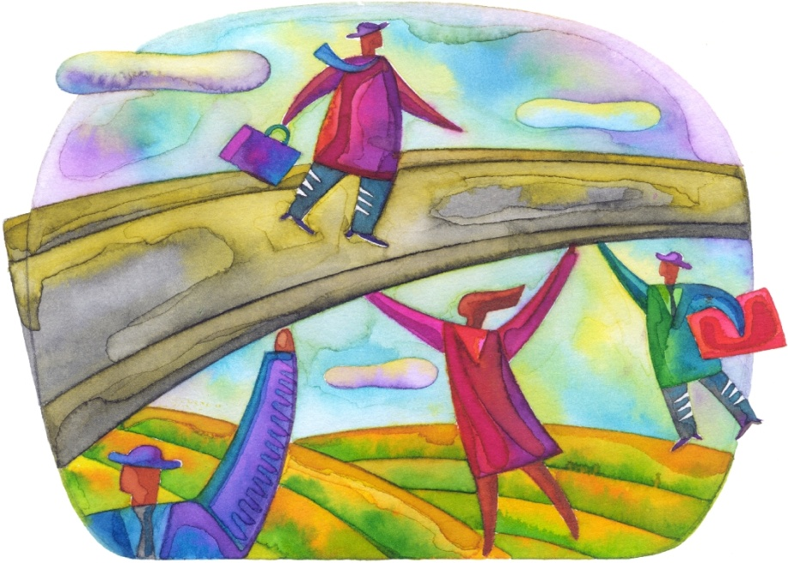

AGING & DISABILITY RESOURCE CONNECTION (ADRC) OF NEVADA COUNTY
Goal of ADRC is to streamline access to long term services and supports (LTSS).
Collaboration between FREED and Agency on Aging Area 4 and other providers of LTSS and safety net services.
Services and supports based on individuals needs and regardless of age, income, or disability.
4 Core services – Enhanced Information & Assistance, Short Term Service Coordination, Person Centered Options Counseling, and Transition

Slide 7
FREED’s ROLE IN EMERGENCY RESPONSE
ONGOING BASIS
Work with local OES on emergency planning and sheltering needs
Provide information to consumers on personal preparedness
Sign-up consumers for notification and alert systems
Participate in state-wide advocacy regarding AFN
Identifying individuals who are at-risk due to power shut offs
LEADING-UP & DURING
Call consumers in our database in the impacted areas
Work with consumers who have lost AT for replacement
Suspend normal intake process during emergency
Embed a staff person in the county operations center
Visit shelters to provide support to individuals and technical assistance

Slide 8
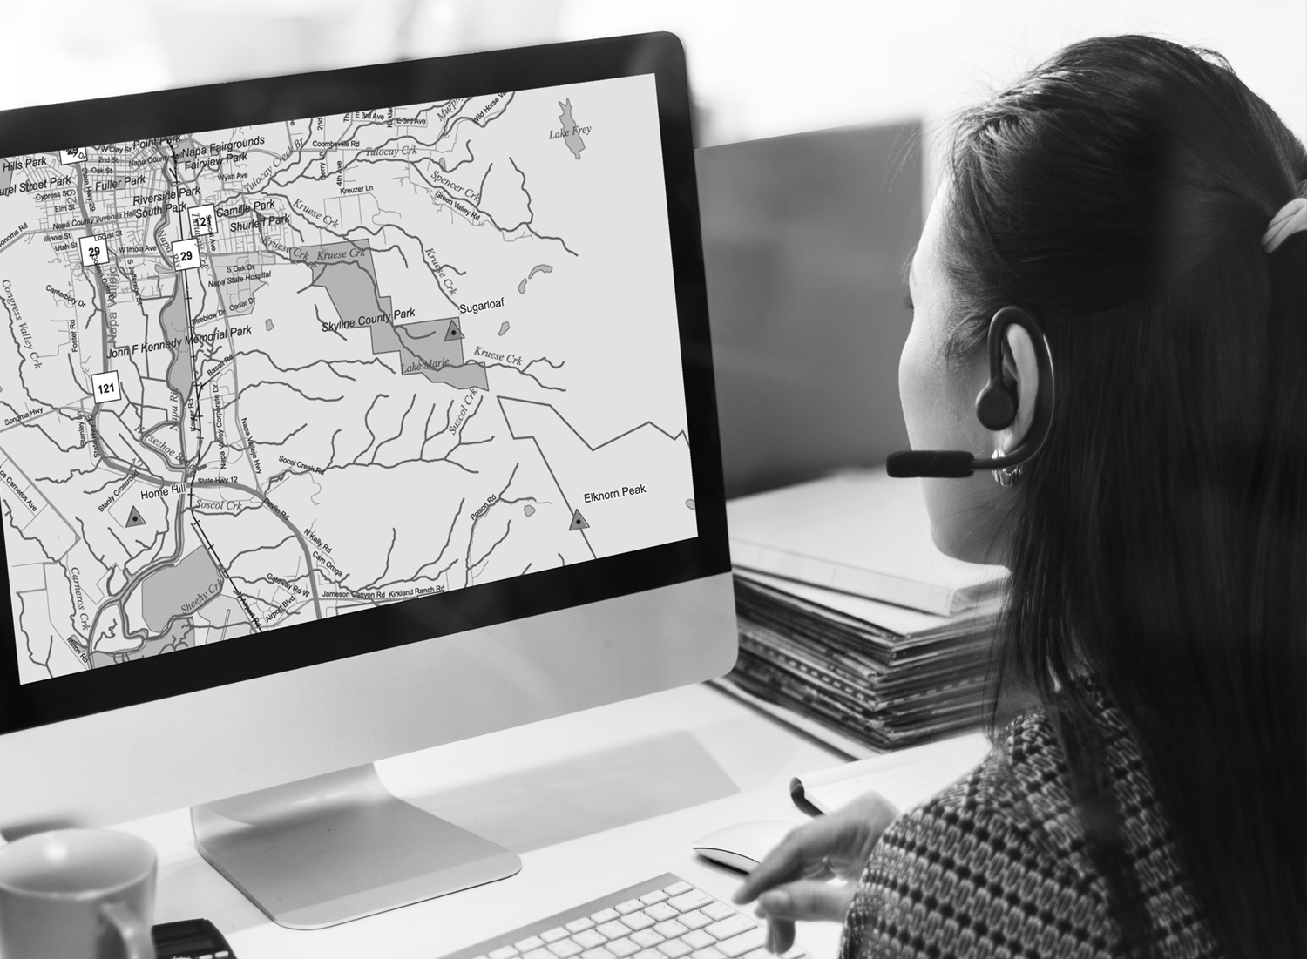
POWER SHUT-OFF
DE-ENERGIZATION
In October 2019, PG&E executed 5 PSPS event in FREED’s catchment area in the northern Sierra Nevada foothills area due to elevated wildfire risk
People with disabilities and older adults require power for life-sustaining measures or independent living

Slide 9

PSPS TIMELINE
September
Event #1: September 23-25 - Nevada & Yuba
October
Event #2: October 5th – 6th three counties, Butte, Yuba, and Plumas
Event #3: October 9th –Oct 12th
Event #4: Oct 23rd-Oct 24th
Event #5: Oct 26th-Ot. 28th
Event #6: Oct. 29th-30th
November
Almost Event #7: Nov 19th
Notes:
Event #2: October 9th –Oct 12th
Days of messaging from PG&E, County, and media outlets
36,000 customers in Nevada County lost power to their homes
11 healthcare units, lost power to their facilities and clinics
All Nevada County schools and government buildings announces closure
70% Restored by Oct 11th @ 6pm
100% restored 2300hours Oct 12th
Event #3- Oct 23rd-Oct 24th
More than 42,000 PG&E customers in Nevada County
More than 189,000 customers effected statewide
After approximately 2 hours of de-energization, PG&E initiates back up generator system that powers areas of downtown Grass Valley
Weather All Clear on Oct. 24th @ 1100hours and restoration efforts begin
100% of Nevada County not restored until Oct. 26th
Forecast show that another event is predicted beginning Saturday Oct 26th
Event #4- Oct 26th-Ot. 28th
Weather forecasted as most significant wind event in 15 years
Extremely high fire danger
approximately 43,211 Nevada County customers effected
Statewide: 33 counties and over 950,000 customers
Nevada County De-Energized Oct. 26th
Weather All Clear given @ 0400 hours on Oct. 28th
Forecast predicts another PSPS event beginning Oct. 29th
Event #5 - Oct. 29th-30th
Smaller scale wind event statewide- effecting less than 430,000 customers
Effecting similar customer volume in Nevada County- 43,211
Many customers were not re-energized between events
De-energization takes place 0800hours Oct. 29th
County buildings and business begin to operate as new normal
Weather All Clear made @ 0522 on Oct. 30th
Nevada County 100% Re-energized by 2100 hours on Oct. 31st

Slide 10
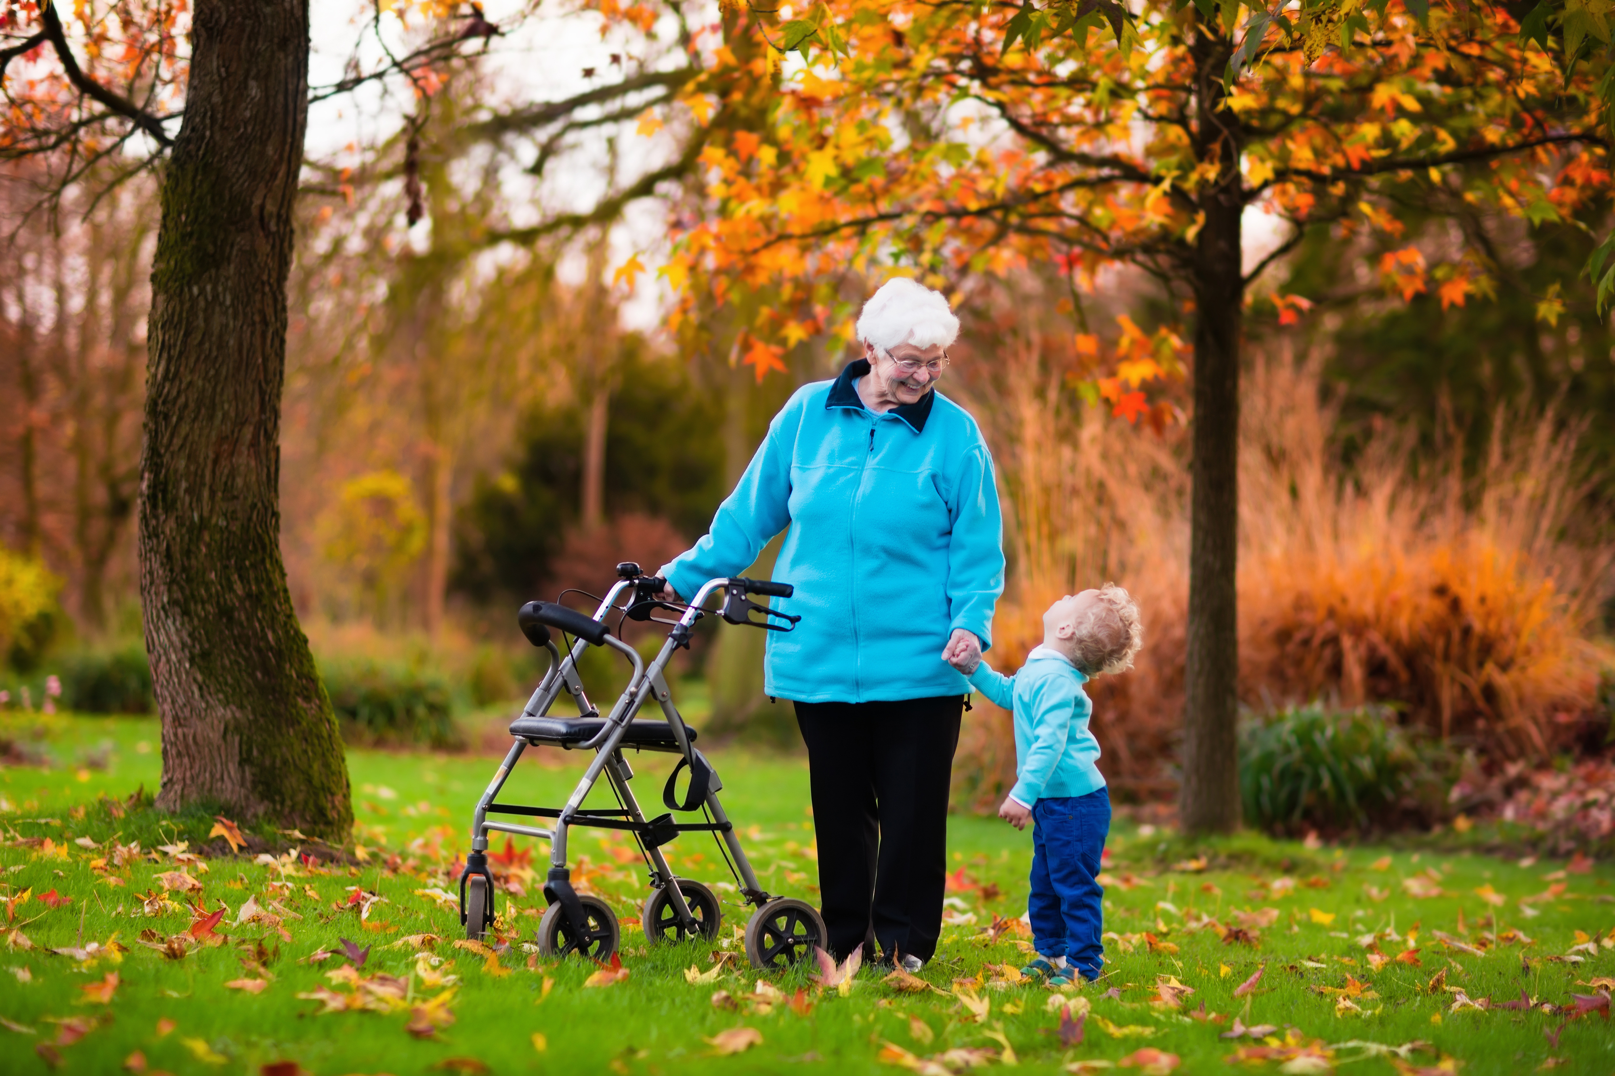
STORIES FROM THE COMMUNITY
Individuals dependent on power for medical devices or assistive technology.
Notes:
Consumer with only 6 hours left on oxygen tank, was laying down in bed and not moving to conserve oxygen - got into a hotel
Mutiple consumers dialed down their oxygen levels to try to conserve oxygen
concentrator with battery that lasts 4 hours before having to be re-charged. When asked what he did during the last PSPS he said he drove around every 4 hours to try to find power, on SSI, said he couldn't do it again - put in hotel
Mutiple people who use C-paps. One person was so exhausted and tired and said she just needed a place with power so that she could sleep. Said when she sleeps, she falls stops breatihing once per miniute
Man on oxygen and on SSI contacted 211 and was referred to FREED. When asked what he did during the last PSPS, he said he drove around every 4 hours tryign to find power to re-charge his oxygen concentrator. Put him in hotel, provided hotel vouchers. Told staff that we saved his life.

Slide 11
FREED PSPS RELIEF EFFORT SNAPSHOT
Serving Nevada, Sierra, Yuba, Sutter, and Colusa
Received 198 incoming calls
80 individuals were served, batteries, hotels, gasoline
Made 18 hotel arrangements for a total of 67 nights
Transported 6 individuals to hotels
Provided 24 people with gasoline for generators
Distributed 49 back-up battery charging stations
Charged 26 devices at FREED’s Charging Station - 9 people with multiple devices or returning consumers
Hotspot purchased in order to continue working while power was out
FREED staff incurred 24.4 overtime hours
Designated staff for: (1) intake; (2) hotel and transportation; (3) battery distribution; volunteers for moving and dropping off batteries
Follow-up and home visits performed

Slide 12
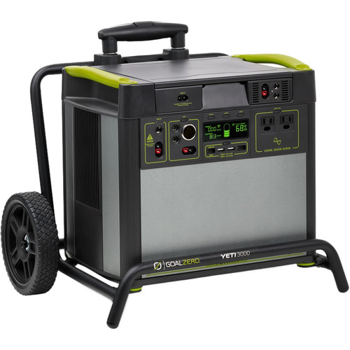
GOAL ZERO Yeti 3000 Lithium Portable Power Station with Wi-Fi
Works well for c-pap, bi-pap, part-time minimal oxygen, charging wheelchairs
Most people (unless only using for c-pap or bi-pap) required daytime charging at a CRC or other location
For some it worked well WITH a generator back-up system
It requires a certain comfort level with technology – or support for troubleshooting.
Can take up to 25 hours to receive a full recharge

Slide 13
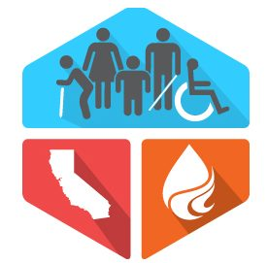
WHAT WORKED
PG&E Coordination of Resources
Quick organization and response
Hotel Vouchers
Batteries
Food Vouchers
Transportation Vouchers
Provided back up generation to areas of downtown Grass Valley, including hospital, Skilled Nursing Facilities, hotels, gas stations, FREED
Community Resource Centers – expanded from 1 to 3

Slide 14
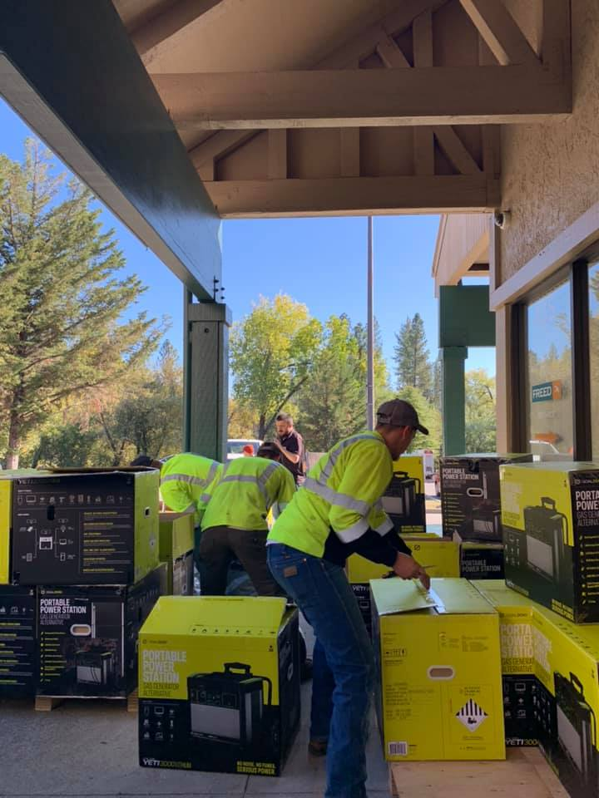
WHAT WORKED
Pre-screening consumers before the PSPS event – assess community need
County Messaging to Community Partners & Public
Marketing & outreach - DHHS, PG&E, other community partners
County Emergency Alerts
Nevada County OES Facebook
Local media
FREED considered a critical service
Forwarding FREED calls after hours to staff cell phones
Hot spot to address no internet and phones
Follow-up calls to consumers who got batteries to improve usability

Slide 15
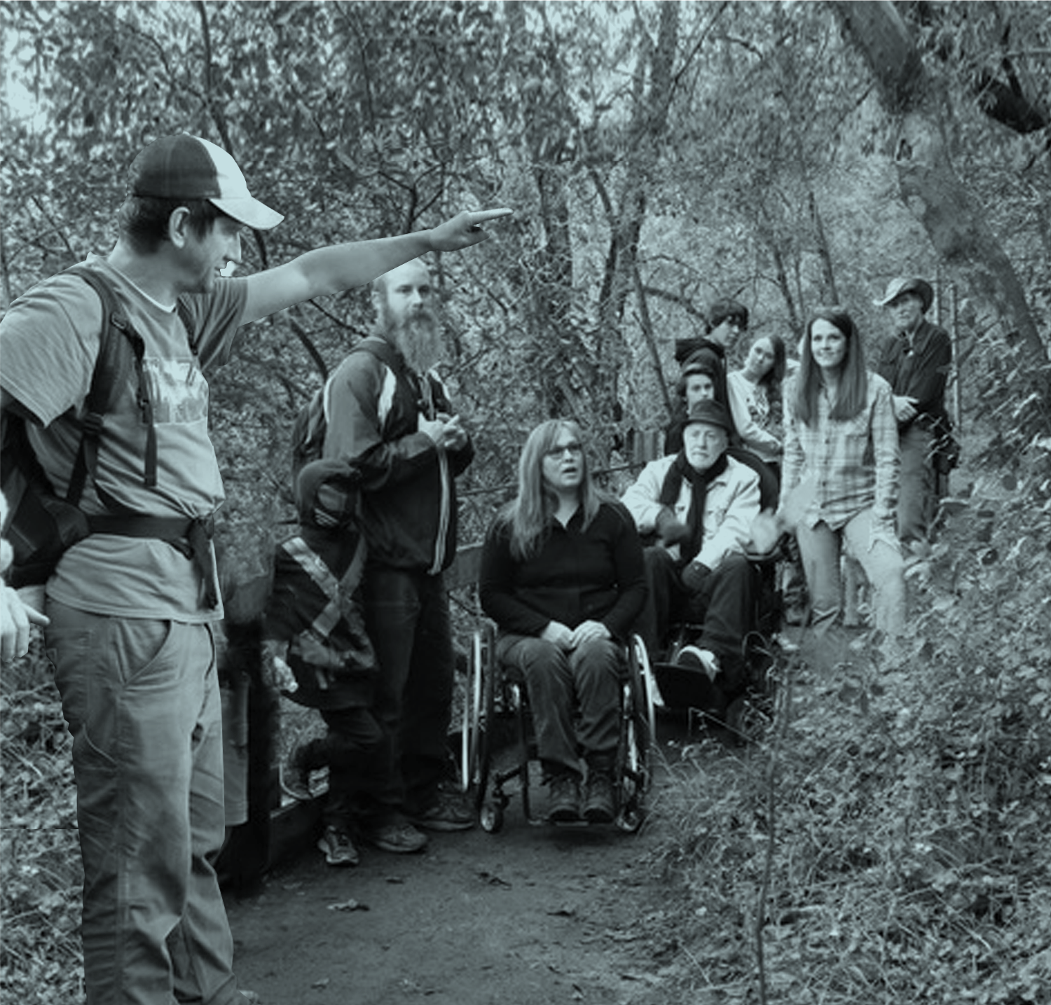
WHAT WORKED
Coordination
Emergency Operations Center Coordination is key
211 operating in the EOC = direct feedback loop
211/County/FREED shared database for coordination
211 – 24/7 call center pre-screening
FREED/Foodbank adapt and serve large populations
Strong relationship, collaboration, and coordination with County OES and Public Health
County OES emails to community partners multiple times a day

Slide 16
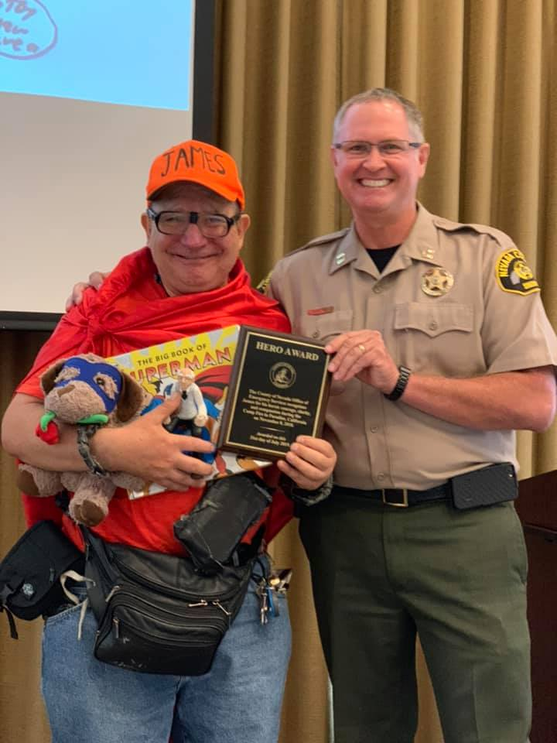
WHAT WORKED
Coordination Cont.
Homeless shelter recuperative care coordination
Hospital Navigation - Reduced hospitalization
Fire Safe Council
Volunteer support

Slide 17
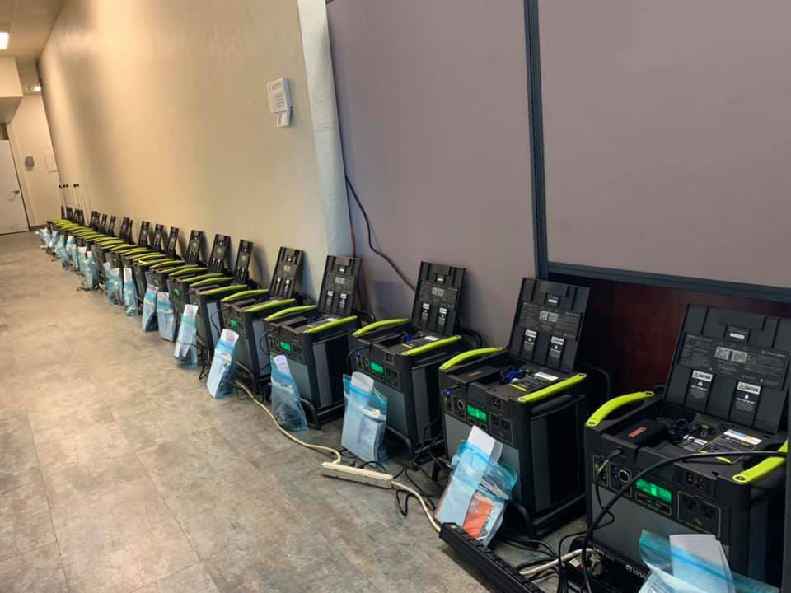
BARRIERS
Back to back PSPS events - some with no power for 7/8 days
Standing up a program in the middle of PSPS
Limited fuel sources for vital services and general public
Access to oxygen
Single pharmacy
Inability for individuals to refrigerate expensive medications
Notes:
back-to-back PSPS events decreases resilency. We say people who were ok for the first PSPS but then hadn't recovered in time for the next.

Slide 18
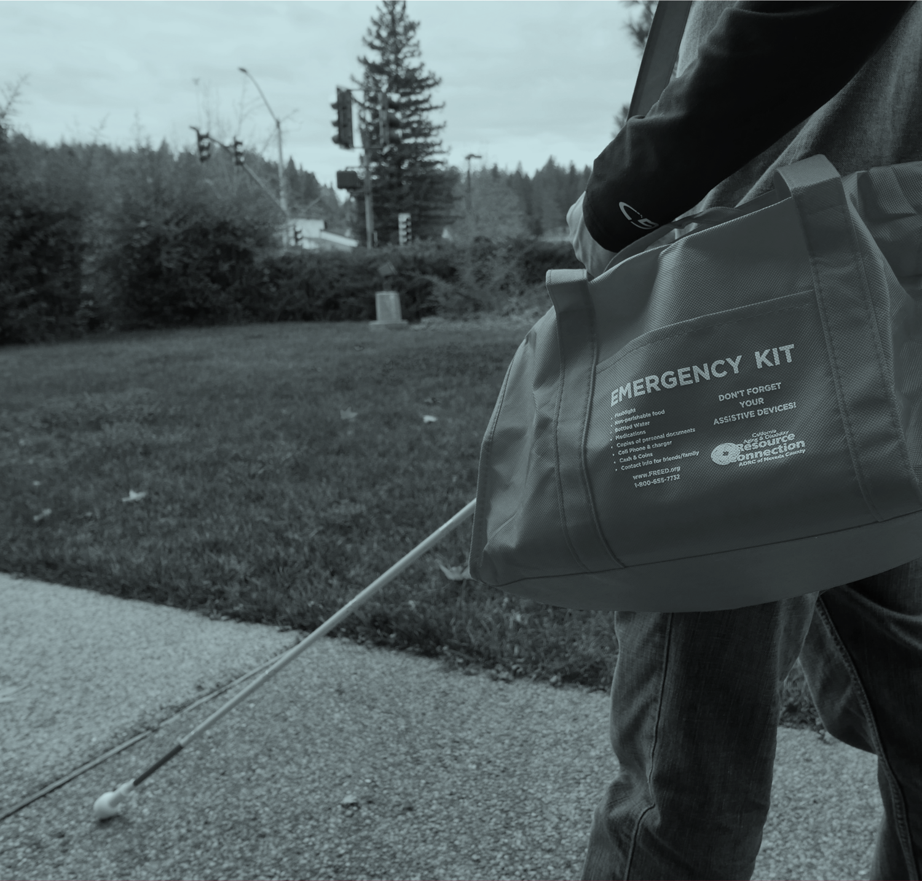
BARRIERS
Community Resource Centers - Limited hours, unmet need for overnight charging of DME, privacy, temporary tents
Organizations ceasing service during PSPS
Re-energizing “surges” damaging equipment and household appliances costing business owners and families thousands of dollars
Messaging
  PG&E inconsistent
  Lost Phone and Internet services
  PG&E outage maps not up-to-date

Slide 19

BARRIERS
Crisis for individuals dependent on electricity for life sustaining devices
Individuals with no plan
Dropping temperatures and an ability to stay warm
Batteries, hotels did not meet all needs
Batteries too technical for some
Notes:
Some people need power 24/7
Back-up battery charging stations do not work for people who utlize high levels of power for AT/DME or who need heat. Also, taking people out of their homes and into hotels is problematic as their homes have the accomodations they need.

Slide 20
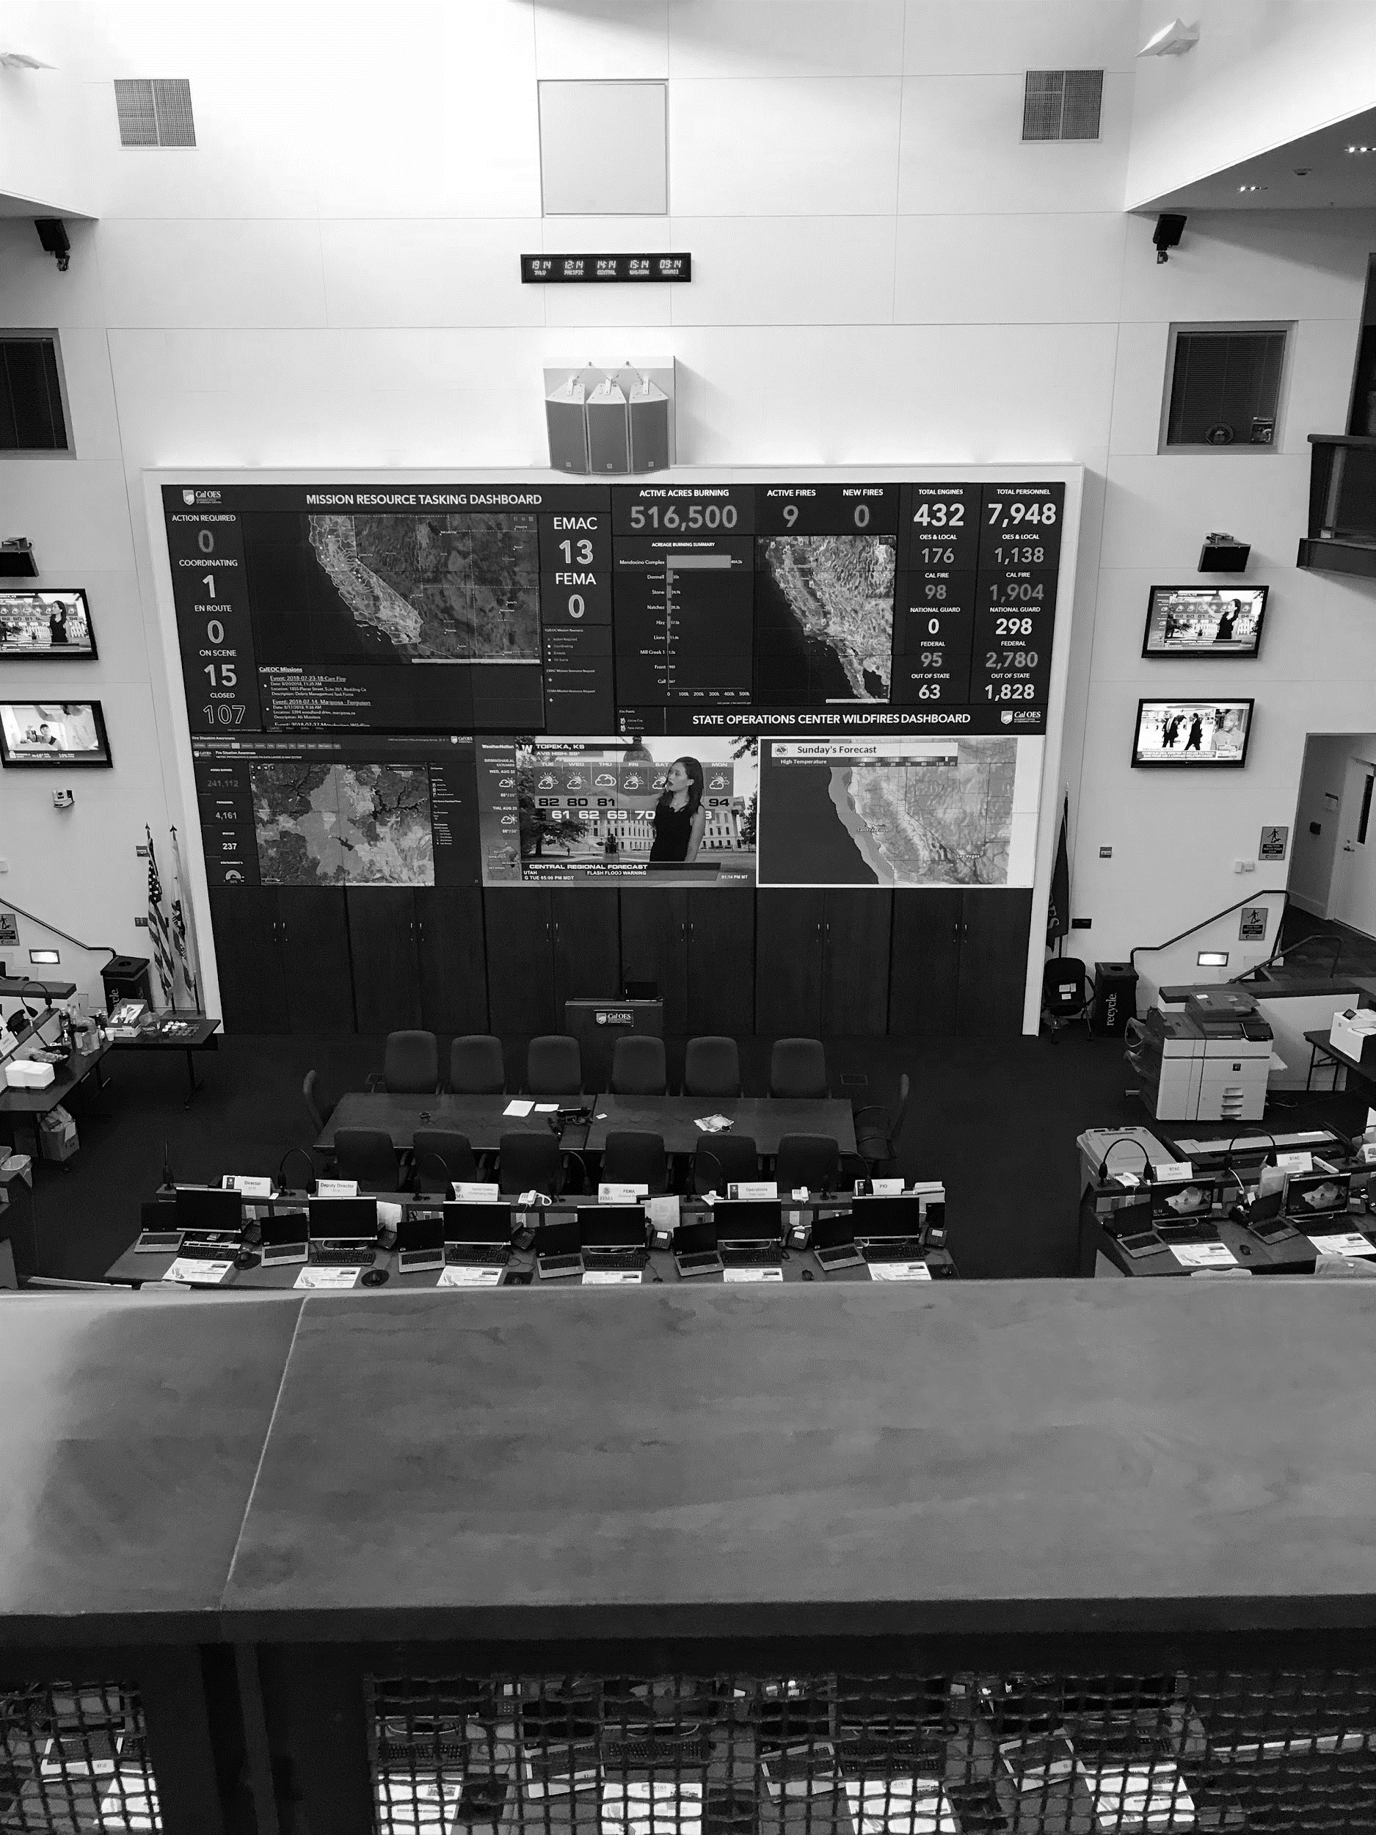
STRATEGIES
Coordinate across public and private partners – organizations that already interface with AFN
Proactively identify, outreach, and plan with people who depend on power
Diverse solutions for diverse needs – back-up battery charging stations, whole house systems, hotels
Organizations build capacity to work remote, without access to power or phones

Slide 21
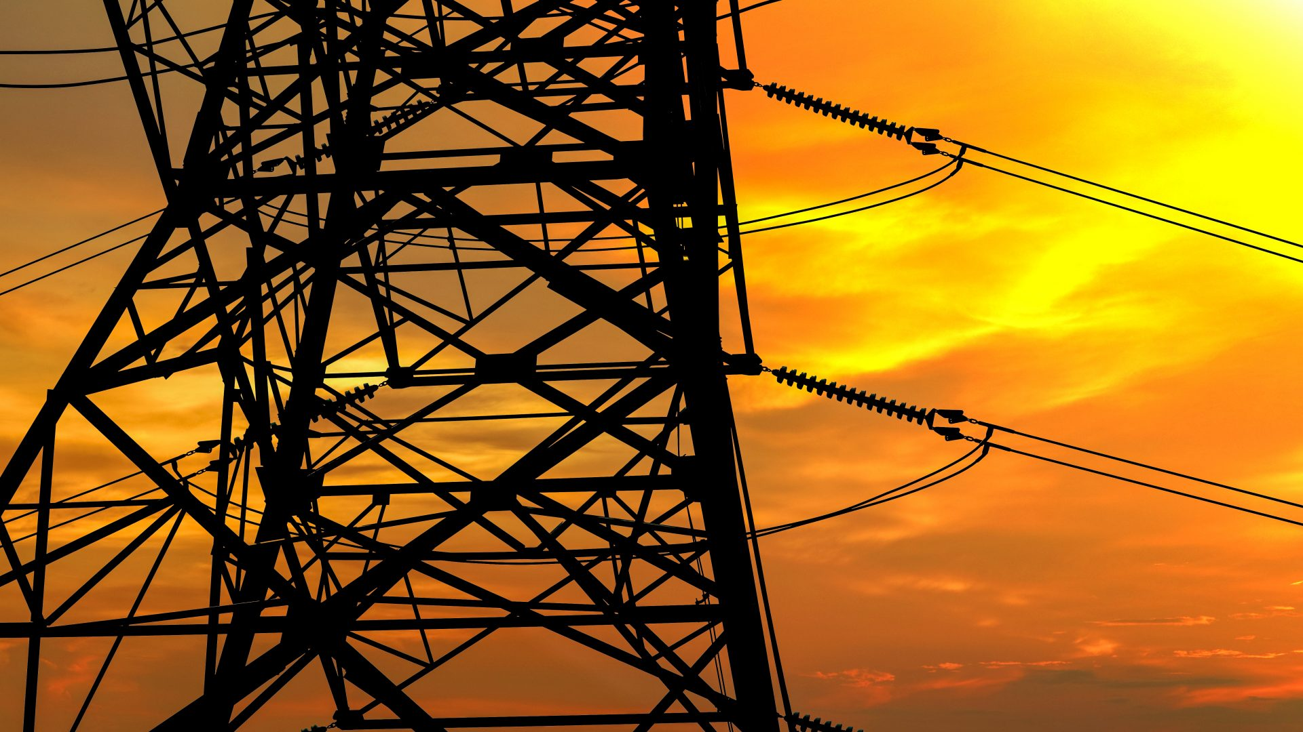
STRATEGIES
Utilities develop mechanism to keep power on to critical infrastructure
Utilities improve communication including to community partners
Community Resource Centers – overnight, drop off DME, brick and mortar, privacy, charge multiple devices

Slide 22

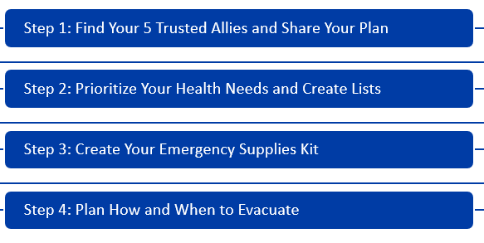
LISTOS CALIFORNIA CAMPATING
$50 M urgency legislation (AB 72) to establish the “California for All Emergency Preparedness Campaign”
The campaign will bolster the efforts of first-responders by ensuring at least one million of the most vulnerable Californians are connected to culturally and linguistically competent support to plan for emergencies.
Pacific ADA Center Partnership
https://www.listoscalifornia.org/
Notes:
$50 M urgency legislation (AB 72) to establish the “California for All Emergency Preparedness Campaign”
The campaign will bolster the efforts of first-responders by ensuring at least one million of the most vulnerable Californians are connected to culturally and linguistically competent support

Slide 23
LISTOS CAMPAIGN NEVADA COUNTY
Pacific ADA Center Nevada County Partners
FREED
Nevada-Sierra Connecting Point Public Authority
Gold County Community Services
Neighborhood Center of the Arts
Sierra Foothills Village
The Food Bank of Nevada County

Slide 24
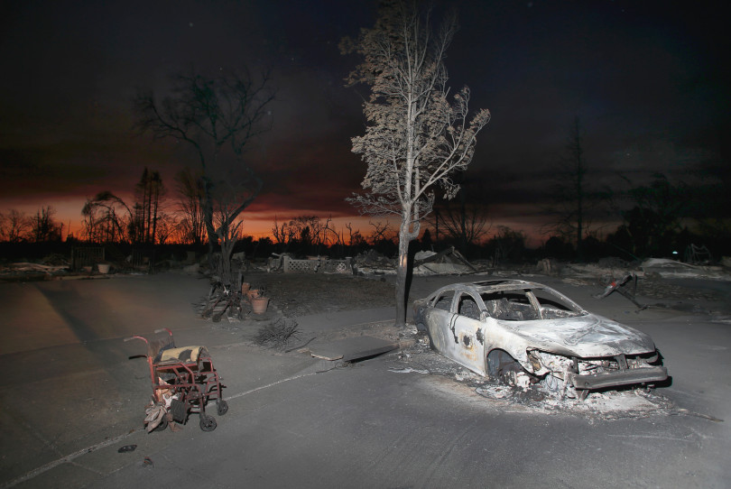
QUESTIONS

Slide 25

Using the California Public
Safety Power Shutoffs (PSPS) for Inclusive Emergency Planning
Christina Mills, Executive Director
California Foundation for
Independent Living Centers (CFILC)

Slide 26
Mission Statement
To increase access and equal opportunity
for people with disabilities by building the capacity of Independent Living Centers.

Slide 27
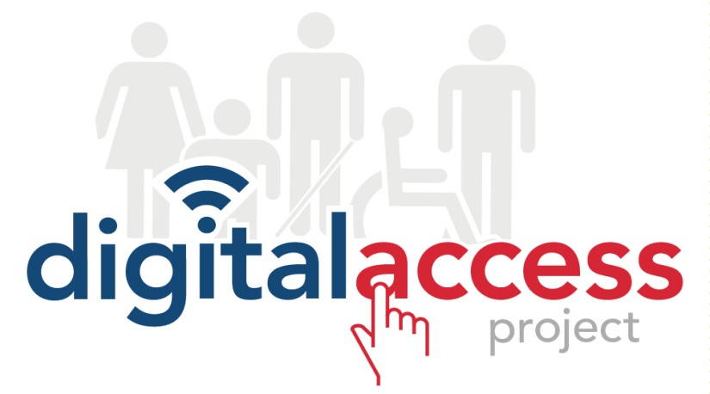




CFILC programs
Membership/
Public Policy

Slide 28
CFILC members
CFILC is not an Independent Living Center
Independent Living Centers (ILC) make-up CFILCs board of directors and our membership. CFILC’s membership covers 56 of California’s 58 counties.
CFILC membership directory, http://www.cfilc.org/members/meet-members.php

Slide 29
How did we get here?
CFILC and Independent Living Centers:
Commissioned after action disaster reports
Sponsor, support and oppose legislation
Provide expert witness testimony
Host and participate in disability disaster coalitions
Regional & local OES coordination and planning
Functional Assessment Service Teams (FAST)
Virtual and onsite shelter accessibility support
Fulfill AT and DME needs or provide referrals
Advisory committee and board participation
Established the Richard Devylder Disaster Relief Fund
Accessible Charging Stations at ILCs
Pacific Gas & Electricity Contract

Slide 30
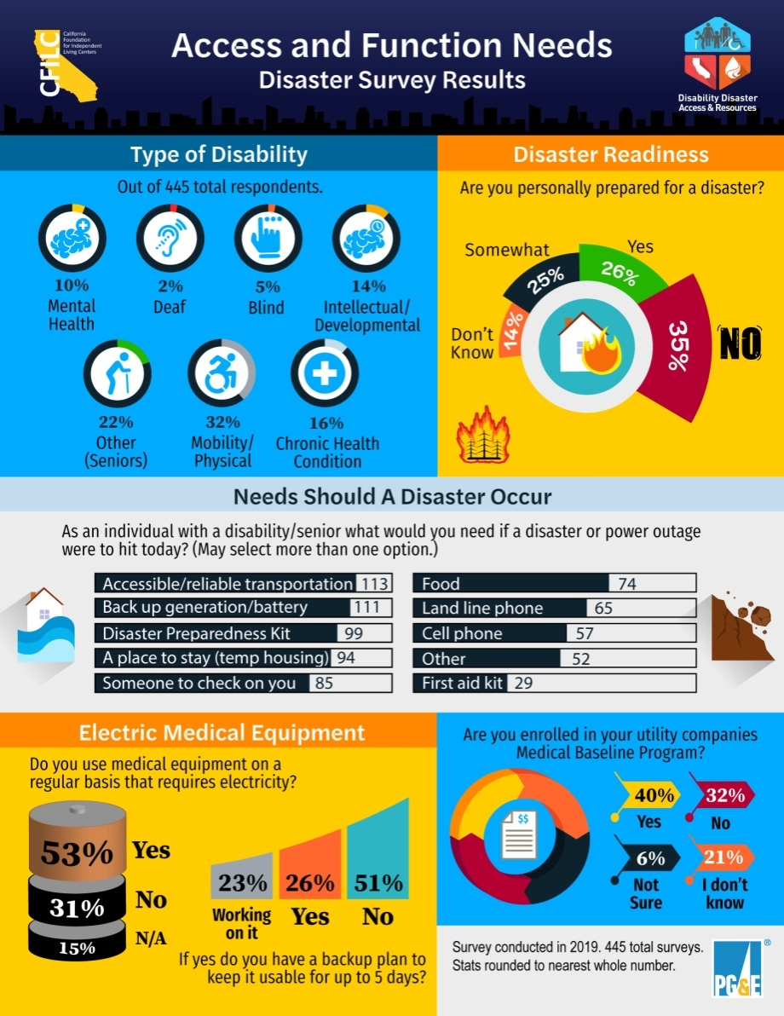
Community Assessment

Slide 31
CFILC Pilot Program
CFILC Disability Disaster Access & Resources Public Safety Power Shutoff (PSPS)
Pilot Program
Funded by Pacific Gas & Electricity
www.disabilitydisasteraccess.org

Slide 32
2019 PSPS Research & Impacts
Developed relationships with battery vendors
Small Sample Tests of AT/DME w/ Batteries
Received over 1000 incoming calls from individuals impacted
Provided 250 batteries to individuals
Assisted with over 82 hotels stays
Over 250 meals were provided
Assisted over 40 individuals with transportation/gas

Slide 33
2019 Lessons Learned
Every individuals situation is unique
Eligibility for PSPS resources need to be on a individual by individual basis
Batteries are a band aid
Educating and working with individuals to develop a long term sustainable disaster/PSPS plan is critical
Resources are limited and only reach so many individuals

Slide 34
2020 Pilot Program
Prioritizing Tier 3 areas of California first and Tier 2 areas second
Statewide uniformed consistency, but with local expertise
Educating and enrolling qualified individuals into the Medical Baseline Programs
Assist in meaningful long-term disaster/PSPS plans
Providing training and public awareness

Slide 35
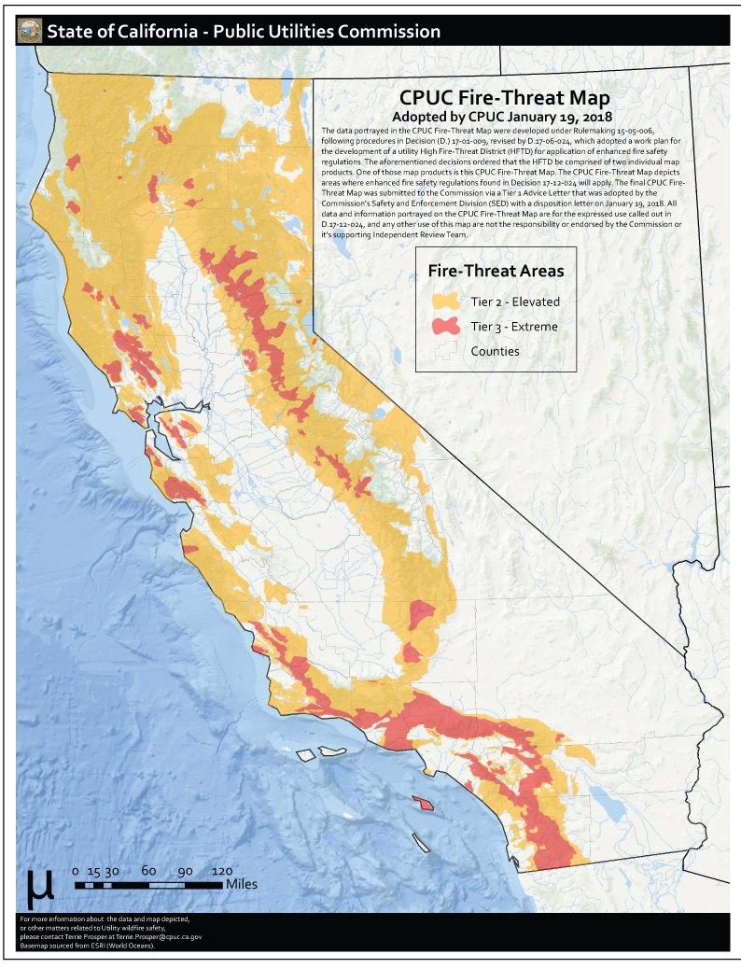
Most Vulnerable Counties
Tier 3
Alameda
Alpine
Amador
Butte
Calaveras
Contra Costa
El Dorado
Fresno
Humboldt
Kern Lake
Los Angeles
Madera
Marin
Mariposa
Medocino
Monterey
Napa
Nevada
Orange
Riverside
San Bernardino
San Diego
San Luis Obispo
San Mateo
Santa Barbara
Santa Cruz
Shasta
Sierra
Siskiyou
Sonoma
Tuolumne
Ventura
https://ia.cpuc.ca.gov/firemap/

Slide 36
PSPS Pilot Partners
All counties are covered by the pilot
except for San Diego and Imperial
20 ILCs are engaged as partners and will be partnering regionally and locally with CBO’s in their respective areas

Slide 37
What is a Pilot Program?
A small scale preliminary program or study that is conducted in order to evaluate feasibility, duration, cost, adverse events, and improve upon prior to performance of a full-scale program.
There is no road map for what we are doing.

Slide 38
PSPS Pilot Priorities
A) Keep people with disabilities that have access and functional needs safe
B) Provide support and resources to individuals with disabilities who use electric powered AT or DME devices before, during & after a PSPS
C) Bust the Medical Baseline Myth and increase the number of individuals eligible for the program
D) Assist in personal preparedness planning
E) Organize and conduct informational trainings
F) Host and participate in public awareness activities to educate the community on disaster related AT tools & devices during a disaster

Slide 39
How does it work?
Applying for PSPS Resources
Online application or Independent Living Center
Individualized Needs Assessment
Support in Enrolling in the Medical Baseline Program
Support in setting up a personalized disaster plan
Determining PSPS Resources Strategy
SAFETY & WELLNESS!

Slide 40
Questions & Comments:
Thank you!
Christina Mills – christina@cfilc.org
(916)838-6472
Follow Us
Twitter - @_CFILC
Facebook - @CFILC.org
Instagram - @cfilc_1982

